Slide 1
BY Shivani priya

Slide 2
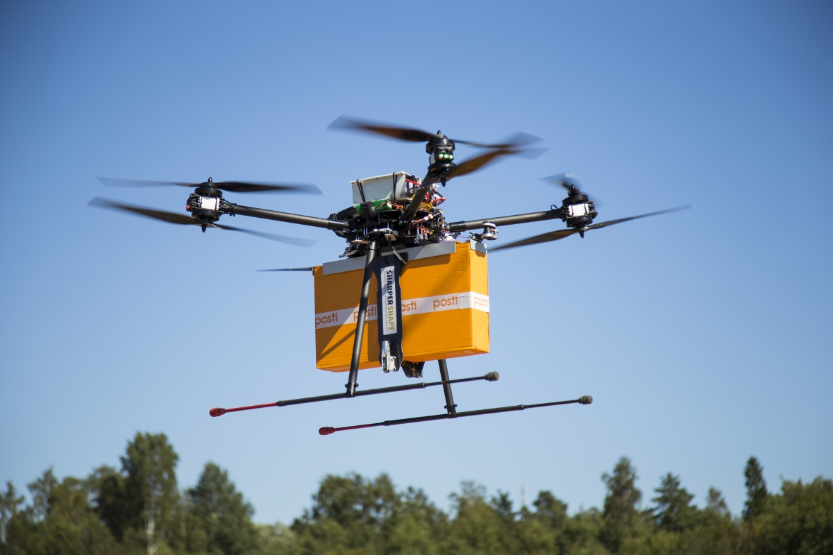
LEGAL PERMISSIONS
The legal requirements and regulations. "HR and legal departments have to be aware of and consistently monitoring the relevant Federal Aviation Administration (FAA) and other state or local rules and regulations governing commercial drone usage and deployment," said Boese, a former HR instructor at the Rochester Institute of Technology in New York. "Some of the key issues for HR are going to be around privacy, access to private airspace—in the case of deliveries, for example—and safety."

Slide 3
find out what is needed to deliver on customer satisfaction
Find out what is needed to deliver on customer satisfaction
Talent management isn’t something that should be taken lightly. In order for HR to support business growth, its staff must be willing to anticipate where the void needs to be filled. First, management must identify where the support is needed the most and in what order to ensure that quality products are delivered and that customer satisfaction is at an all time high. For example, if your sales team is underperforming due to a lack in resources, it may be time to consider hiring for the support they need in order to generate more business sales.

Slide 4
TRAINING FOR EFFECTIVE USE
The recruiting and training challenges. Because commercial drone operation is a pretty new discipline, it is likely that qualified operators are in short supply. "And very few organizations would have any in-house capability or capacity to train their existing employees," Boese said. "This could be an area where HR and training departments have to look to third-party providers … to take some or all of these roles.

Slide 5
THE NEED FOR NICHE SKILLS
The need for niche skills. "Longer-term, HR leaders would need to think about commercial drone operations like they consider other technical or niche skills," Boese said, for example, whether it makes sense to have people with these capabilities as in-house employees or as part of the extended or contracted workforce.
"Drones can allow certain portions of your more senior workforce to be repurposed into other highly valuable jobs," added Rupprecht.
Using drones "allows HR to start looking into newer areas to acquire talent and character that might have been previously not as realistic (e.g., a double-amputee wounded veteran operating a drone at a construction site)," he wrote in an e-mail.

Slide 6
EFFECTIVNESS IN HR
Communicate Don’t Command. Barking orders at your employees and team will only get you disgruntled and demotivated teams...
Relationships Are Your Foundation to Great HR. Any true leader knows the value of relationships with their team. It is...
Let Them Spread Their Wings. Great HR revolves around letting employees reach their full potential. When employees are...
Nurture Teamwork. Insecurity and intimidation in the workplace doesn’t produce great results. Your...

