Slide 1
Team
Nicolaus

Slide 2
Company Name : Trash Gold
Retail Brand Name: ECO Trendy
Problem
Solid waste generation is one of the three major environmental problems faced by municipalities in the world.
Rapid population expansion and an increase in living standards have created insurmountable issues for Bhopal's municipal solid waste management (MSWM).
NEXT

Slide 3
Uniqueness of our Proposal
Using latest technology with strong IT infrastructure.
Strong focus on becoming completely self-sufficient with initial focus on retail products – a way to “Waste to Wealth”
Initial Focus of convert paper, plastics and related waste into yarn and fabric consecutively and finally into fashion clothing which includes wearables and accessories. With time, also focussing on fuel production from waste & waste in road preparation.
Profitable Financial Model, with investment payback period of 5.47 years and IRR for the period - 18.25%.
Retail Brand Positioning synchronous with current era and trendy in youth.
Employee salary as per industry standards; efforts for high retention rate.
Supporting women workforce, collaborating with NGO for hiring ground level employees
Unique Reward System- “Sant Gadget Baba Award – Youth of India”, Golden Employee Award, Star of the Month Award and various spot awards.
Strong MIS system to inform all stakeholders about progress and current stage of the project.

Slide 4
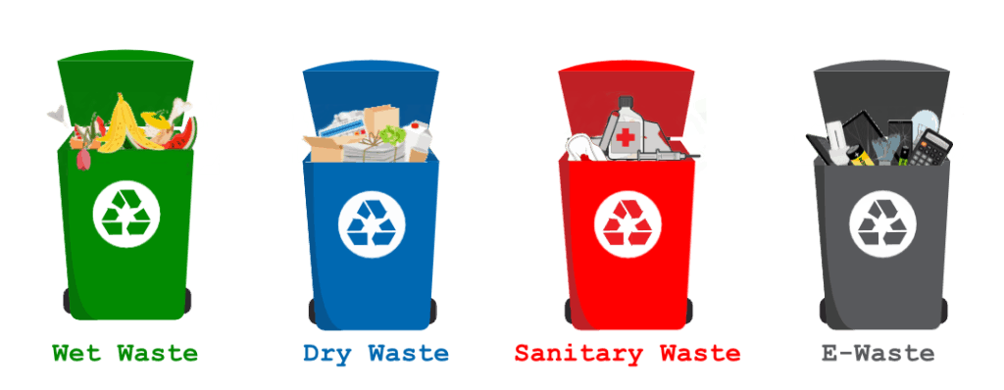
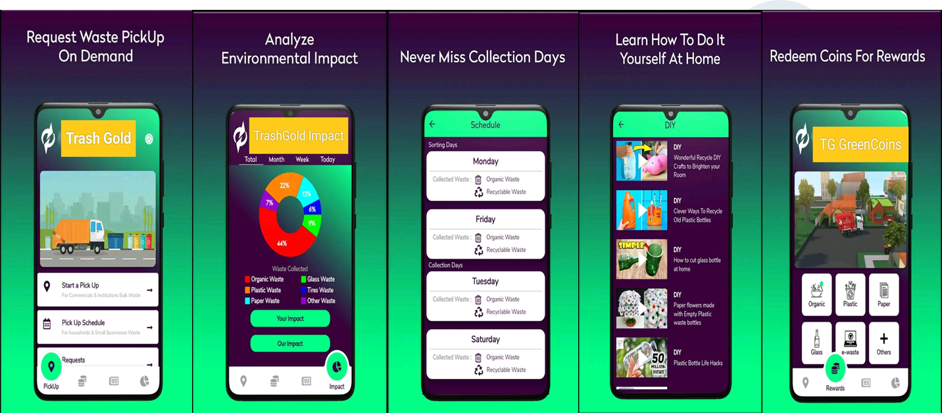
Unique Planned Initiatives
Coloured Dustbin
TrashGold App

Slide 5
Expectation from the Government Bodies
PPP Model proposal – as project will be possible in most of practical initiatives are taken by us and not acting as a consultancy!!
Municipality need to collect all the waste, we as a company will surely support with the technology to make it more efficient and generating better practices.
Once collection is done, we takeover the complete process till finish product and selling of it to consumers too.
Dustbin Color Coding Sensitization is what we will make necessary in all household and commercial points will help of government body.
Expecting monetary support in terms of grants, incentives etc.

