Slide 1
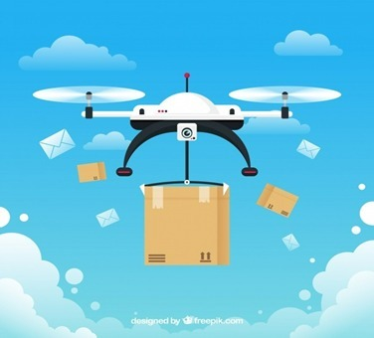
Team Earth
Department of LP
Business Case Scenario – Airway Delivery A New Business Opportunity
Team Leader:- Firake Gunjan Bharat

Slide 2
Company Name – Skyline Courier Services
Logo of Company:-
Tagline:- Your Courier, Our Responsibility.
Vision:- To be the industry leader in service quality.
Mission:- Skyline Courier Services is committed to providing first-class messenger services to its customers 24/7 with reasonable rates on a consistent basis. We enable our customers to prosper by delivering their products on time in a professional manner. We will continuously challenge ourselves to exceed our customers’ expectations by providing leading edge solutions to their needs.

