Slide 1
HRM - SELCO

Slide 2
Different Departments
Functional Department
HR Department
Marketing Department
Finance Department
Production Department
Other StaFF

Slide 3
Training Module –Session1
Duration | 3Hrs
Topic | Give idea about SOLAR Management through Audio & Video clips Some activities to show impact of it Self precautions / Self Care How to use gloves, boots, caps, etc
Trainees | Experience person
Educational Background | Electrical and e&tc engineer , solar management system, application system (appliances)
Type of Training | Interactive Sessions, Practical, Games, Audio & Video
Preferred medium of languages | Hindi/Marathi/English

Slide 4
Training Module –Session2
Duration | 2Hrs
Topic | How use solar system Reduce Reuse Recycle
Trainees | Experience person
Educational Background | A person wo have knowledge of chemicals and environment
Type of Training | Interactive Sessions, Practical, Case Study , Games, Exercise
Preferred medium of languages | Hindi/Marathi/English

Slide 5
Training Module – Session4(For All- In different batches)
Duration | 2 Hrs
Topic | Etiquettes Soft skills for marketers and all other employees Body Languages
Trainees | Experience trainer
Educational Background | BBA+MBA(Marketing & HRM)+PHD(Physiology and human skills)
Type of Training | Interactive Sessions, Practical, Case Study , Games, Exercise
Preferred medium of languages | Hindi/Marathi/English

Slide 6
Training Module – For IT, Marketing , HR
Duration | 5 Hrs
IT | Latest technologies
Marketing | How to be more creative
Sales | How to increase sales
HR | How to increase skills of employee and make them more energetic , crative
Preferred medium of languages | Hindi/Marathi/English

Slide 7
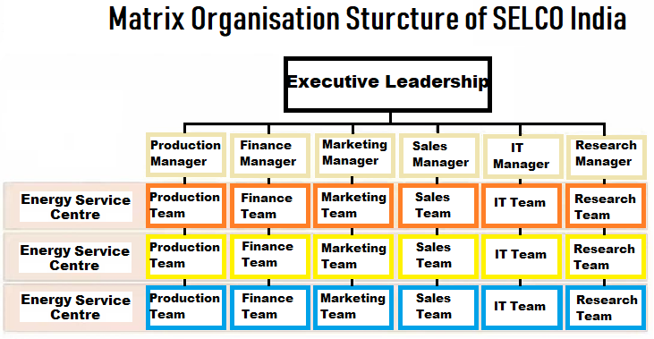
Expansion of Organization

