Slide 1
Finance
DELIVERING LAST MILE SUSTAINABLE ENERGY
Solutions that Improve Quality of Life and
Socio-Economic Development for the Poor

Slide 2
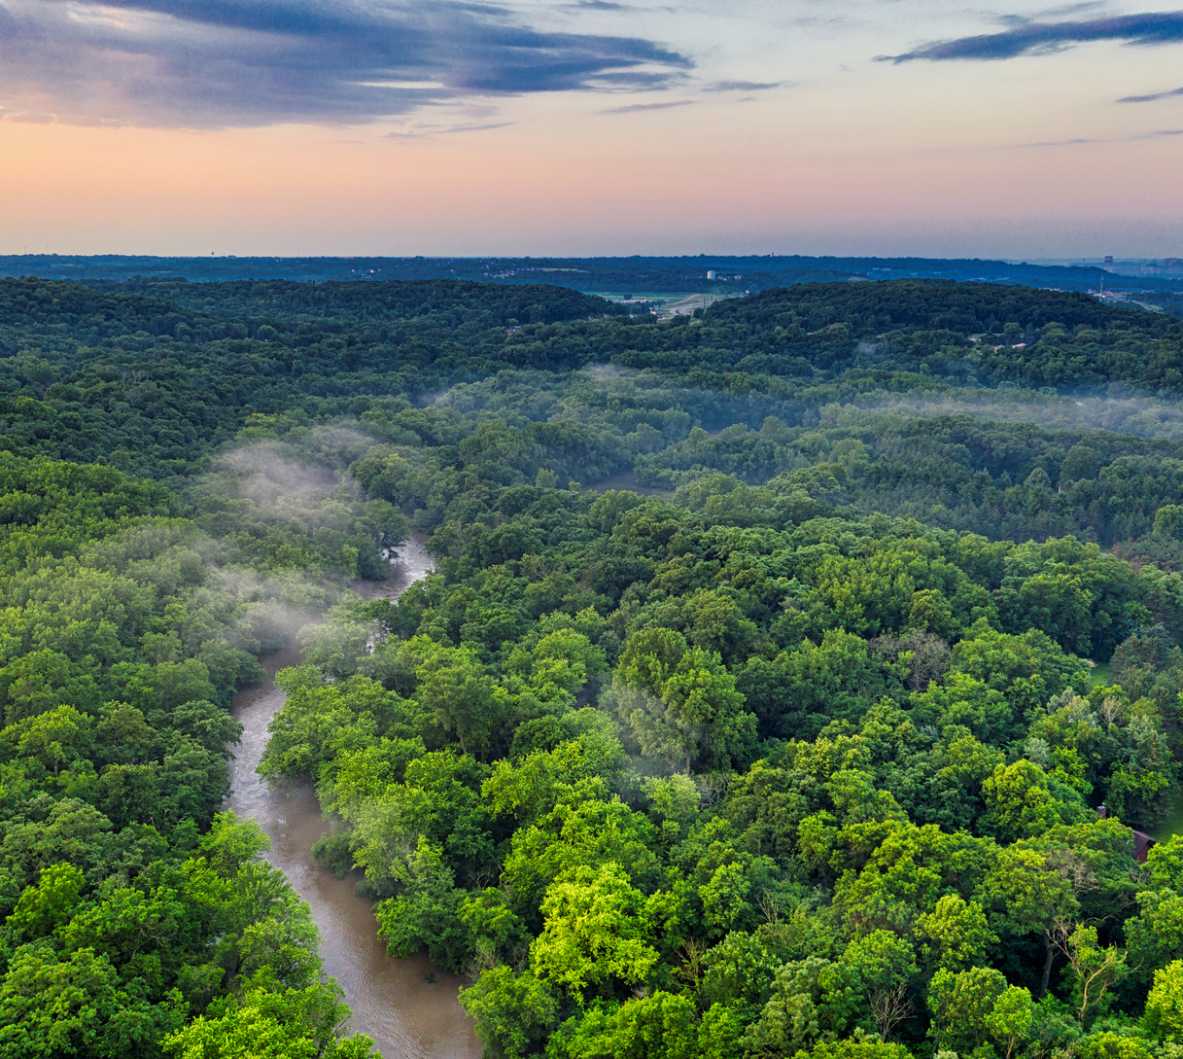
Problem Statement
To propose the solution regarding the financing of the organization with three broad objectives namely
1. Sources of Inflow
2. Sources of Outflow
3. Departmental Budgets and time line
Join Now
Not Now

Slide 3
Conclusion
1. Sources of Inflow
Solution to the Monetary Inflows for the company (Inflow) (PACADI Approach)
The business model does not allow to have a single fit solution to all the projects as the requirement of all will be different. Hence, we propose to raise funding under three buckets categorizing on the basis of the risk and then lending this fund to various project in the same risk categorization and earn the difference in the profit as the revenue for the firm.
Additionally the firm must look for the government project funding that have synergies with our project.
See More
2. Sources of Outflow
Scheduled arrangement for the outflow without disruption (Regular Outflows) (Real World Approach)
See More
3. Departmental Budgets and time line
Funds to cater the untapped 40 crore members to increase the customer base (Large Outflow) (Focused Group Discussion)
Approach Used
Subscribe Us
See More

